Slide 1
DATA MINING PROJECT PREDICT HOUSE PRICE USING REGRESSION
Presented by-
Piyusha jahagirdar
Arnika vishwakarma
Reshma kapadnis

Slide 2
DATA MINING
The gathering of information from pre-existing data stored in a database to identify pattern and relationships within the databases through the use of advance statistical methods.
How we mine the data?
1. Exploring data.
2. Building the model and its validation.
3. Applying the model to the new data.

Slide 3
PROJECT DESCRIPTION
Introduction- Real estate properties are attractive option for safe investment especially for a common person. The direction of changes of the future economy is hard to predict because of international economic direction. Also real estate is investment which does not decline in value rapidly.
Project topic- Predicting house price sales in kings county, USA using regression.
Goal- To determine the factors that affect the price of the house.

Slide 4
Dataset
This dataset contains house sale prices for King County, which includes Seattle. It includes homes sold between May 2014 and May 2015
19 house features plus the price and the id columns, along with 21613 observations.
Constraints
Location specific
Time frame(one year)

Slide 5
MODEL USED
Multiple Linear Regression
Most common form of linear regression.
Used to explain relationship between one dependent and two or more independent variables.
Equation
Y = a+b₁X₁ +b₂X₂ + +b k_{X}
where Y is the dependent (Outcome) variable, and the variables X1….,X k are the explanatory (predictive) variables. The constants b1……….,b k are the regression coefficients and a is regression constant or intercept.

Slide 6
DATASET DETAILS
Location:
https://www.kaggle.com/harlfoxem/housesalesprediction
Total observations : 21613 observations
Total house features : 19 plus price and id
Dependent variable : Price
Independent variable : 19 features

Slide 7
Steps in Data Mining
Load Libraries and dataset
Data Cleaning
Data Transformation
Training and Testing dataset
Regression Model

Slide 8
Multiple linear Regression
In this dependent variable decided by independent variables
Dependent: Price is the only variable which is dependent , Which changes according to the independent variable.
Independent Variable : We took 19 different variables……..
List : Number of bedrooms, Number of bathrooms, sqft of living, Sqft of loft, floors, waterfront , view, condition ,grade, sqft above, sqft basement, year built, year renovated, zip_code , lat , long sqft living15, sqft lot 15
Total = 17

Slide 9
Observations: We are considering total 21613 observations for precise prediction.
Additional Columns: id and date are two additional columns.
Steps used to import dataset:
First save the excel file in csv format.
Open R studio : Import the dataset using read.csv()
e.g. Dataset <- read.csv (“DATASET.csv”)

Slide 10
IMPORTING DATASET
data <- read.csv("C:\\Users\\Dell780\\Dropbox\\Personal\\MS in Computer Science(Ranu)\\FSU\\Assignments\\Introduction to Data Science\\Housesales.csv", header=TRUE)
View(data)
# get the outline of the data
str(data)
head(data)
tail(data)

Slide 11
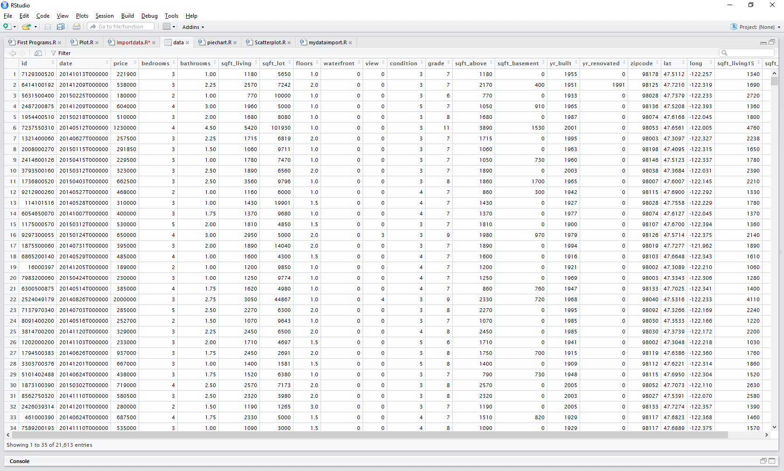

Slide 12
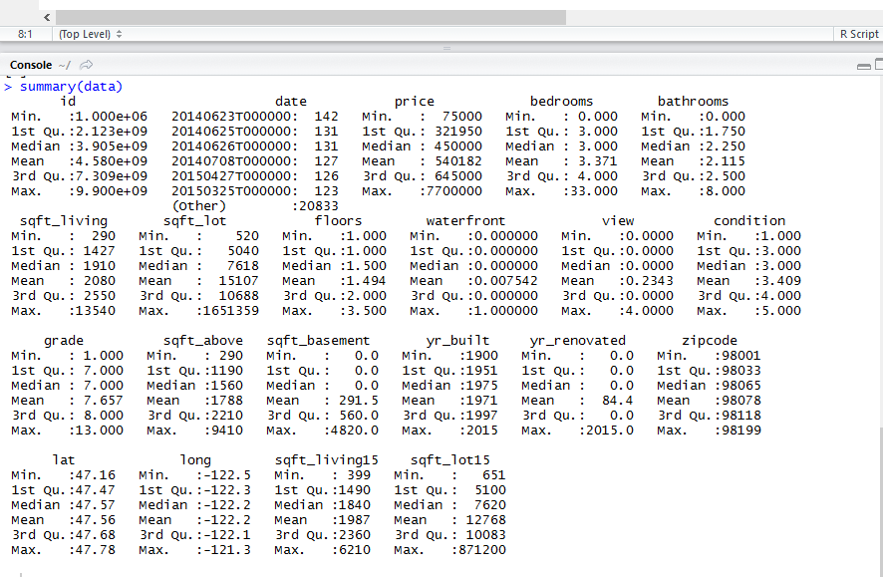
summary(data)

Slide 13
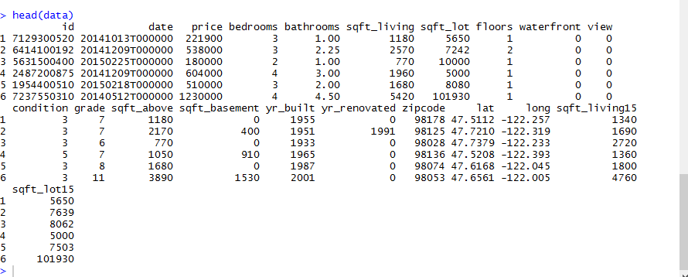
head(data)

Slide 14
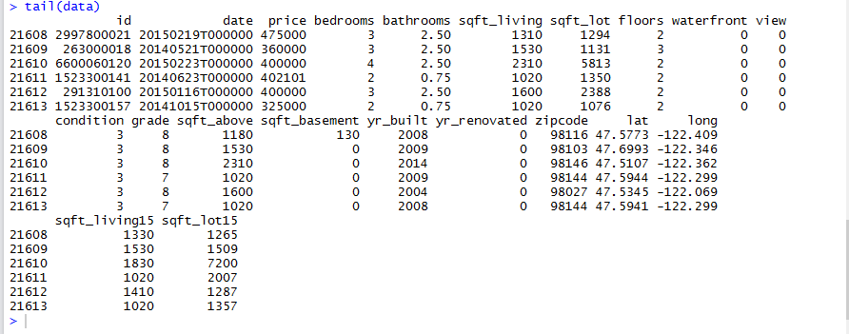
tail(data)

Slide 15
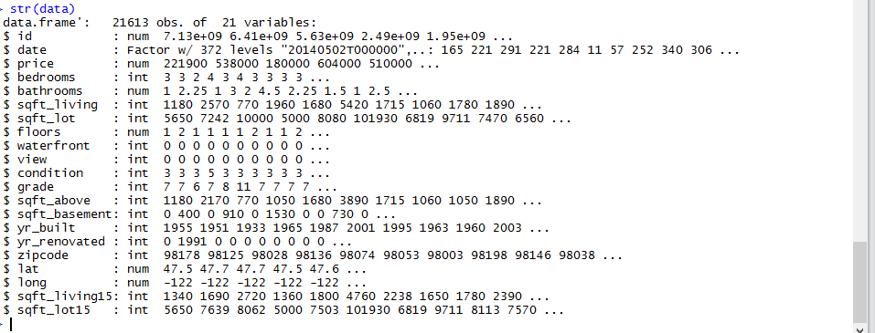
str(data)

Slide 16
DATA CLEANING
It is a process of amending or removing data in database that is incorrect, incomplete, improperly formatted , or duplicated
Steps of Data cleaning:
Exploring data
Tidying data.
Preparing data for analysis.

Slide 17
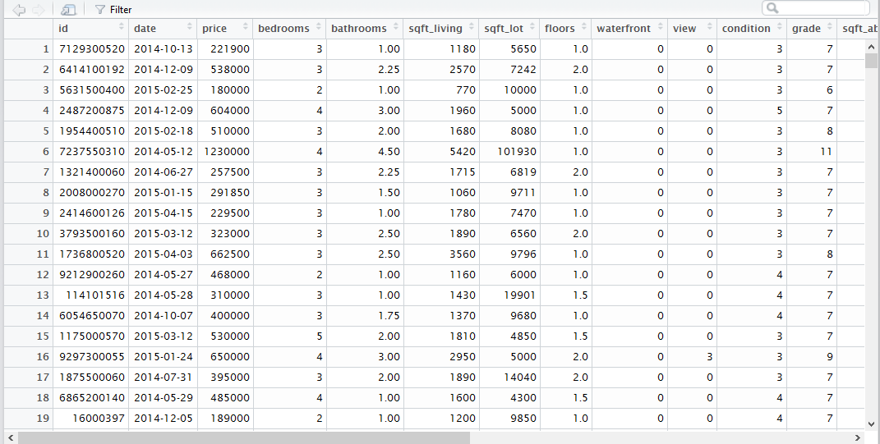
AFTER CLEANING DATASET LOOKS LIKE THIS

Slide 18
TRAINING AND TESTING DATA
Training Dataset- Training Dataset is a set of data which is used to discover potentially predictive relationships.
indexes = sample(1:nrow(HouseDataSet), size = 0.3*nrow(HouseDataSet))
Train_data = HouseDataSet[-indexes,] #Train dataset 70%
dim(Train_data)
Test Dataset – Test dataset is a set of data used to access the strength and utility of a predictive relationship.
Test_data = HouseDataSet[indexes,] #Test dataset 30%
dim(Test_data)

Slide 19
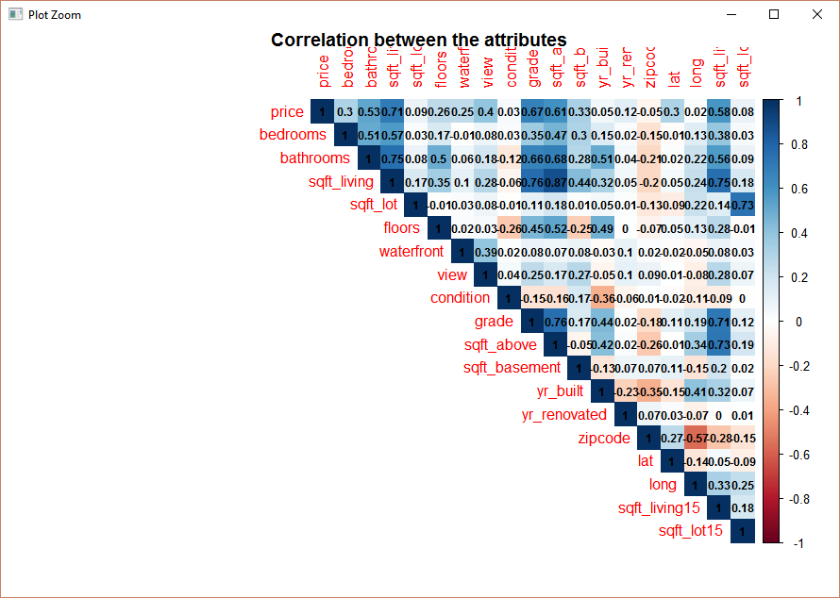
Correlation:
Attribute_Corr <-cor(Train_data[3:21],method="pearson")
View(Attribute_Corr)

Slide 20
CHECKING LINEARITY
Simple linear regression model that describes the relationship between two variables x and y can be expressed by the following equation
Linear models make some strong assumptions concerning the data structure:
Independence of each data points
Correct distribution of the residuals
Correct specification of the variance structure
Linear relationship between the response and the linear predictor

Slide 21
FITTING A MODEL
We tried making 7 models to check for the linear relationship between dependent and independent variables. We found the Housemodel_1 as the fittest model for our predictive model.
R Code:
Housemodel_i1<- lm(log(price) ~ bedrooms+bathrooms+sqft_living+floors+waterfront+view+condition+grade+sqft_above+yr_built+yr_renovated+lat+long+sqft_living15+ sqft_lot15, data = Train_data)
summary(Housemodel_i1) # Multiple R-Squared : 0.7684

Slide 22
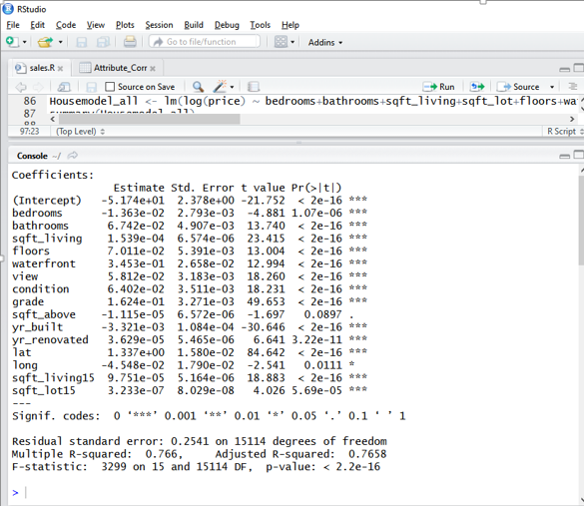

Slide 23
PREDICTING THE NEW PRICE
We applied the predict() to predict the new price of the house using the best fitted linear model.
Equation
Y = a+b₁X₁ +b₂X₂ + +b k_{X}
where Y is the dependent (Outcome) variable, and the variables X1….,X k are the explanatory (predictive) variables. The constants b1……….,b k are the regression coefficients and a is regression constant or intercept
pred <- predict(Housemodel_i1,Test_data)
summary(pred)
View(pred)
View(cbind("ID"=Test_data$id,"Orginal Price"=Test_data$price,"New predicted price"=exp(pred)))

Slide 24
FUTURE ENHANCEMENT
Further we decided to create models for our dataset using different regression methods like- Ridge Regression, Lasso Regression. For as of now, we predicted the price of house sales using only multiple regression because of the time constraint.
Different parameters can be taken into consideration:
1. We can considering more parameters to get the correct results as per the user requirements.
2. We can consider different types of homes like Colonial, Raised Raches, Condominiums etc.
3.We can also consider and classify if the house is FHA approved or not.
Area demands:
1.Each area has different demands like in California and Arizona most people prefer to have a swimming pool where as in New England there isn’t a big demand for swimming pools. So we can consider and sort data according to similar factors for more precise results.

Slide 25
REFERENCES
Kaggle.com
Data Mining –concepts, Models & Techniques.
R Data Mining -Yanchang Zhao

Slide 26
THANK YOU

